Slide 1
PLT Internship 2012
Erik Nelson

Slide 2
Part One: The Work

Slide 3
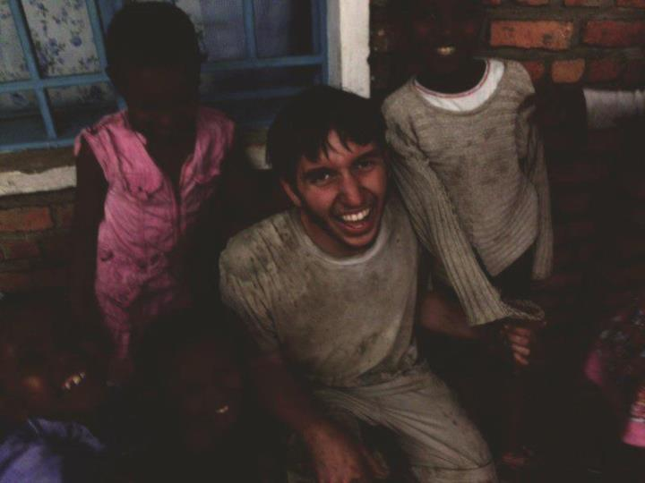
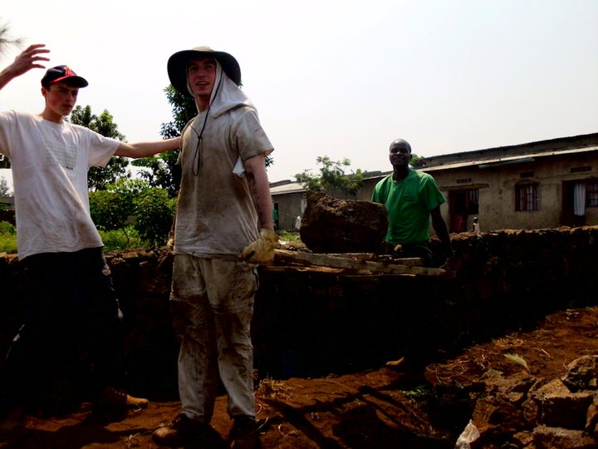
Previous Experience
Worked in Rwanda during the Summer of 2011 with the African Great Lakes Initiative

Slide 4
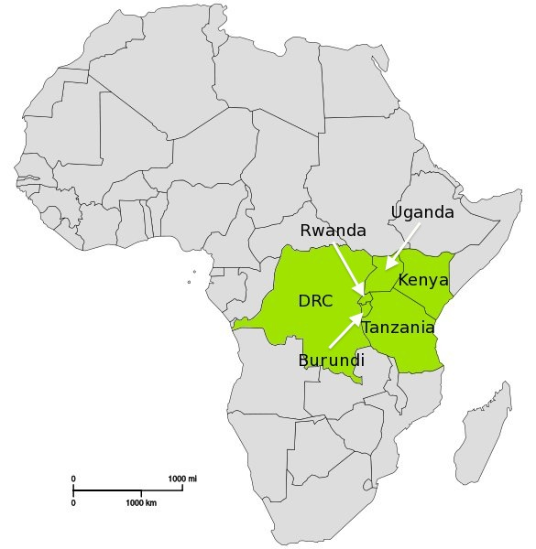
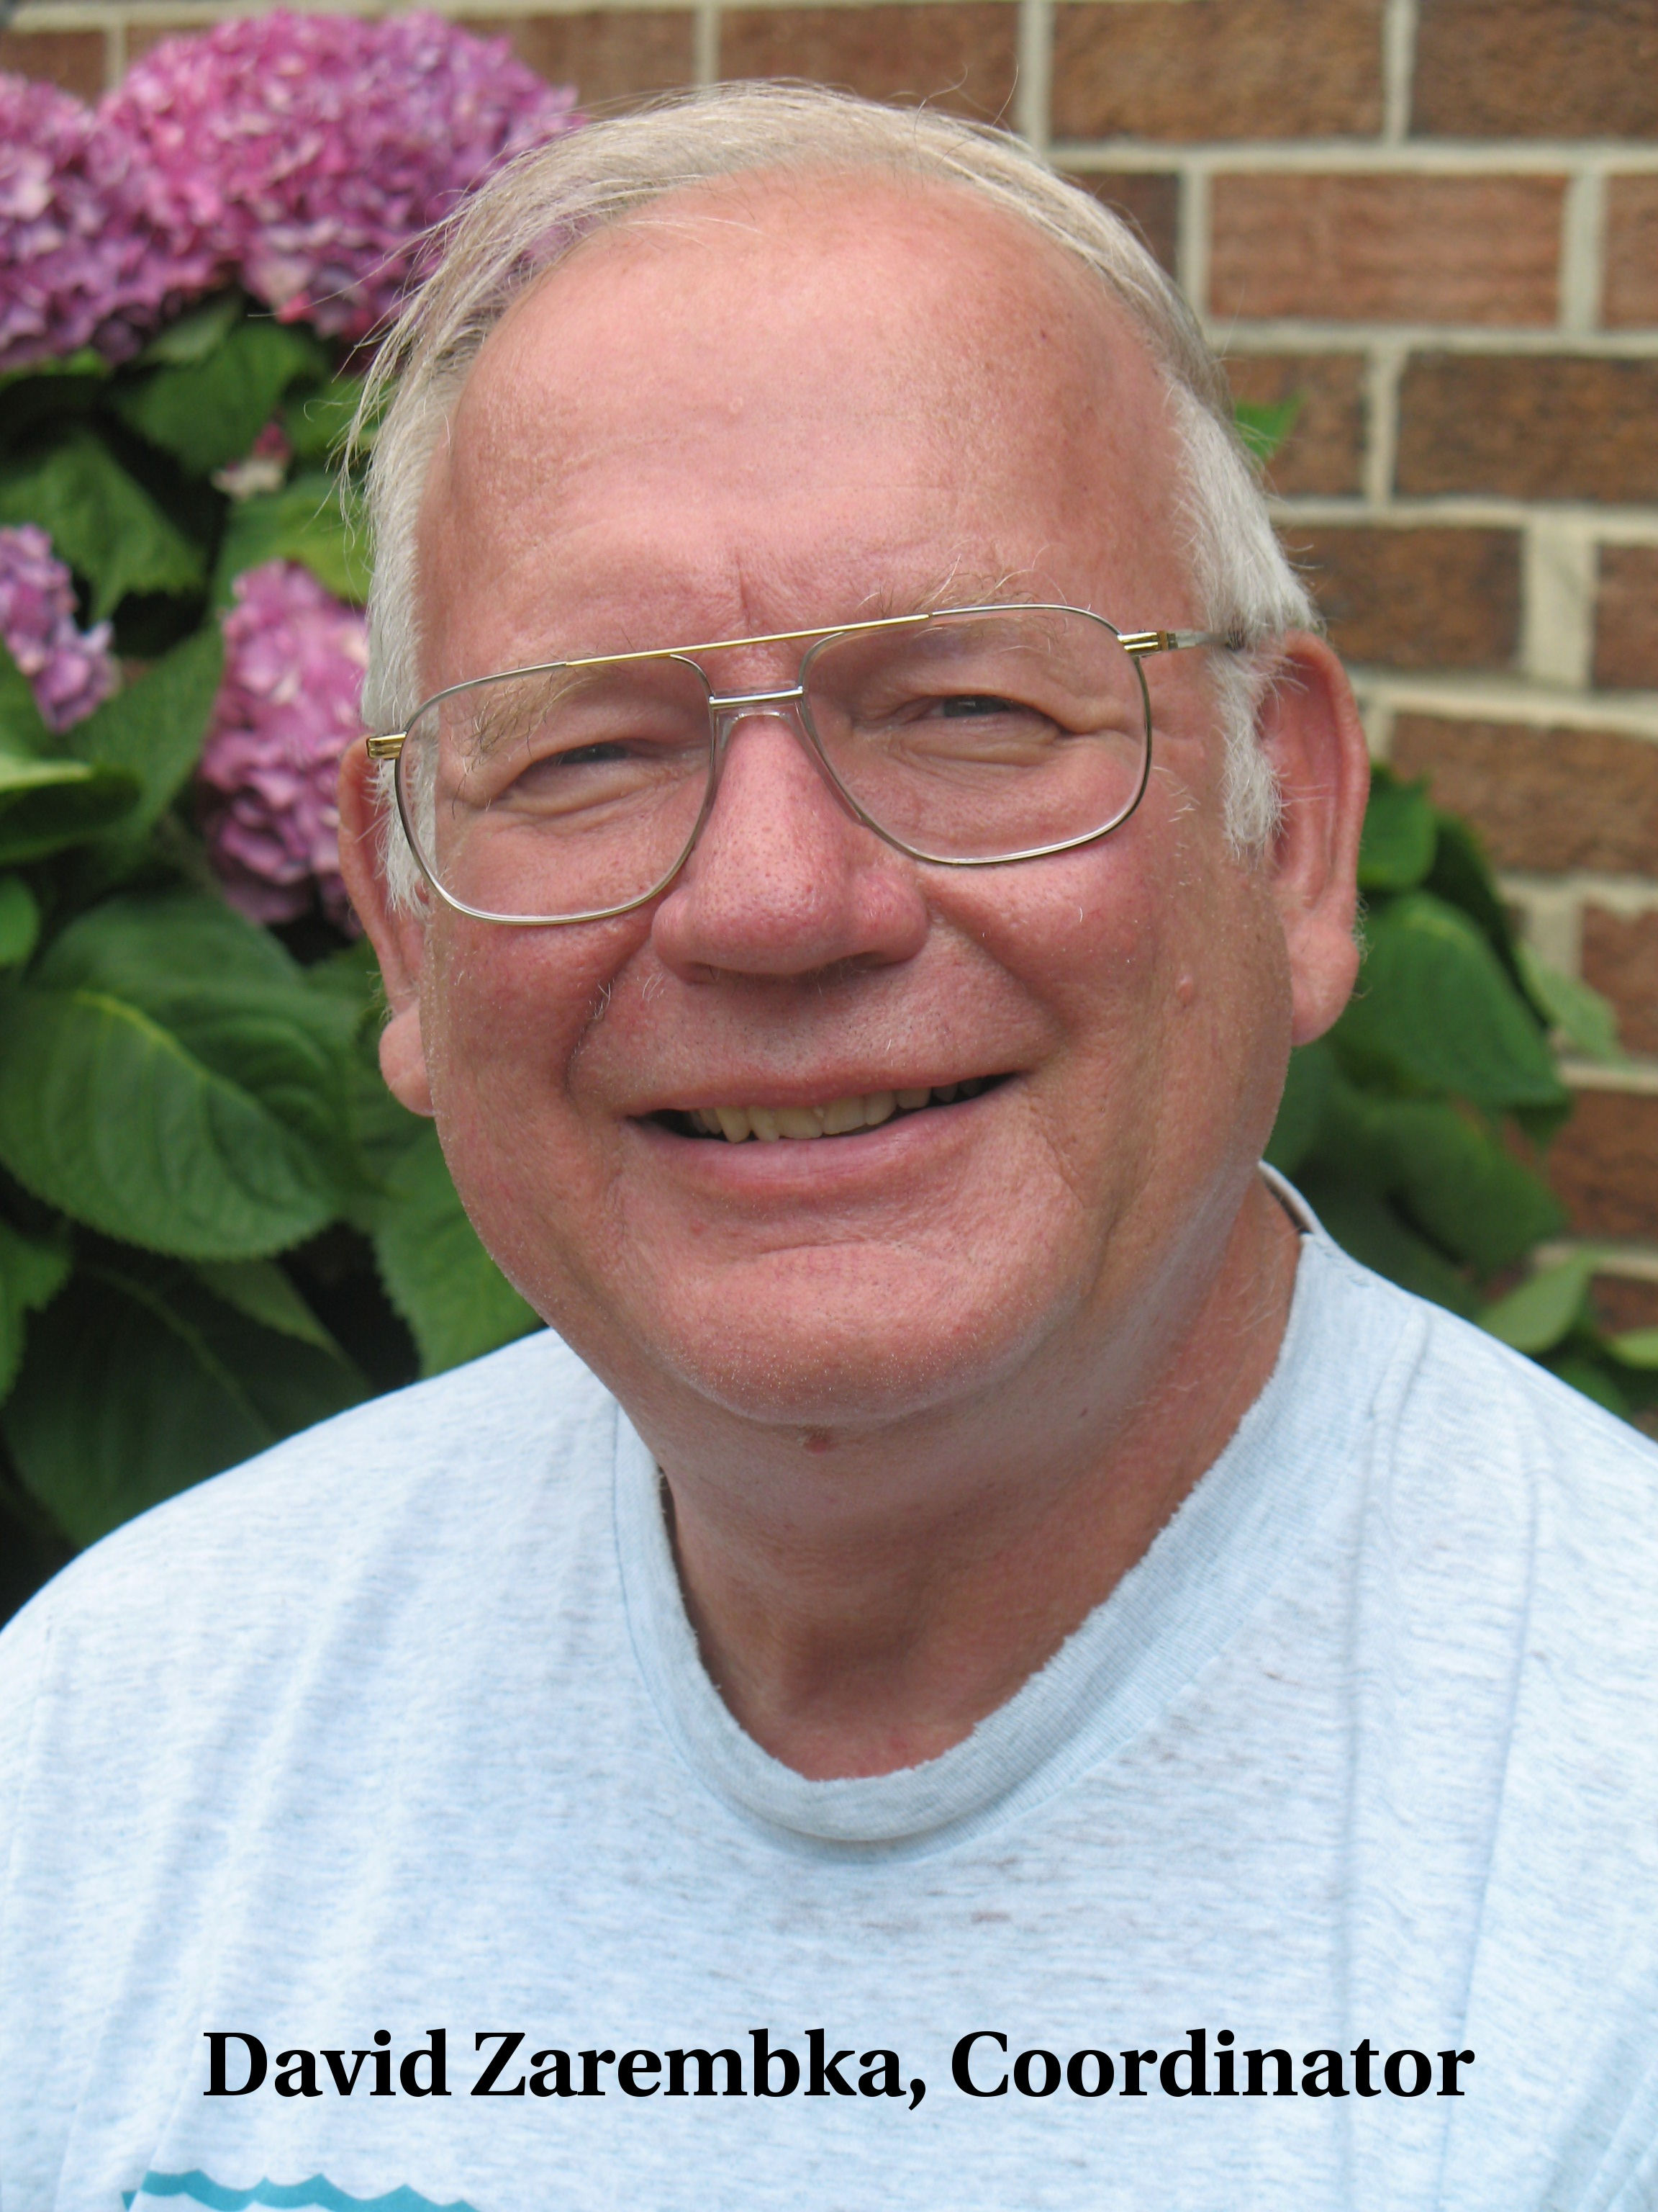
The Work of AGLI
“[T]he important point [of AGLI’s work in Africa] was that they were so pleased that someone from the outside had come to visit. They felt that someone recognized and remembered them. This gave them hope.” – David Zarembka

Slide 5
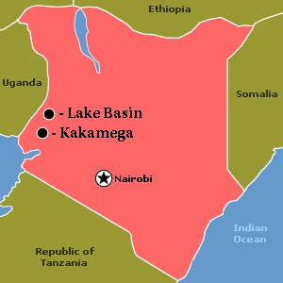
My Time in Kenya
First Month: Lived in a small town outside of Kakamega in the house of two, married English teachers. Did construction work, taught some English, cut grass, milked cows and assisted AGLI facilitators.
Second Month: Lived in a remote location known as Lake Basin. Dug trenches, installed pipes, repaired a roof, renovated buildings and taught (and learned!) skills.

Slide 6
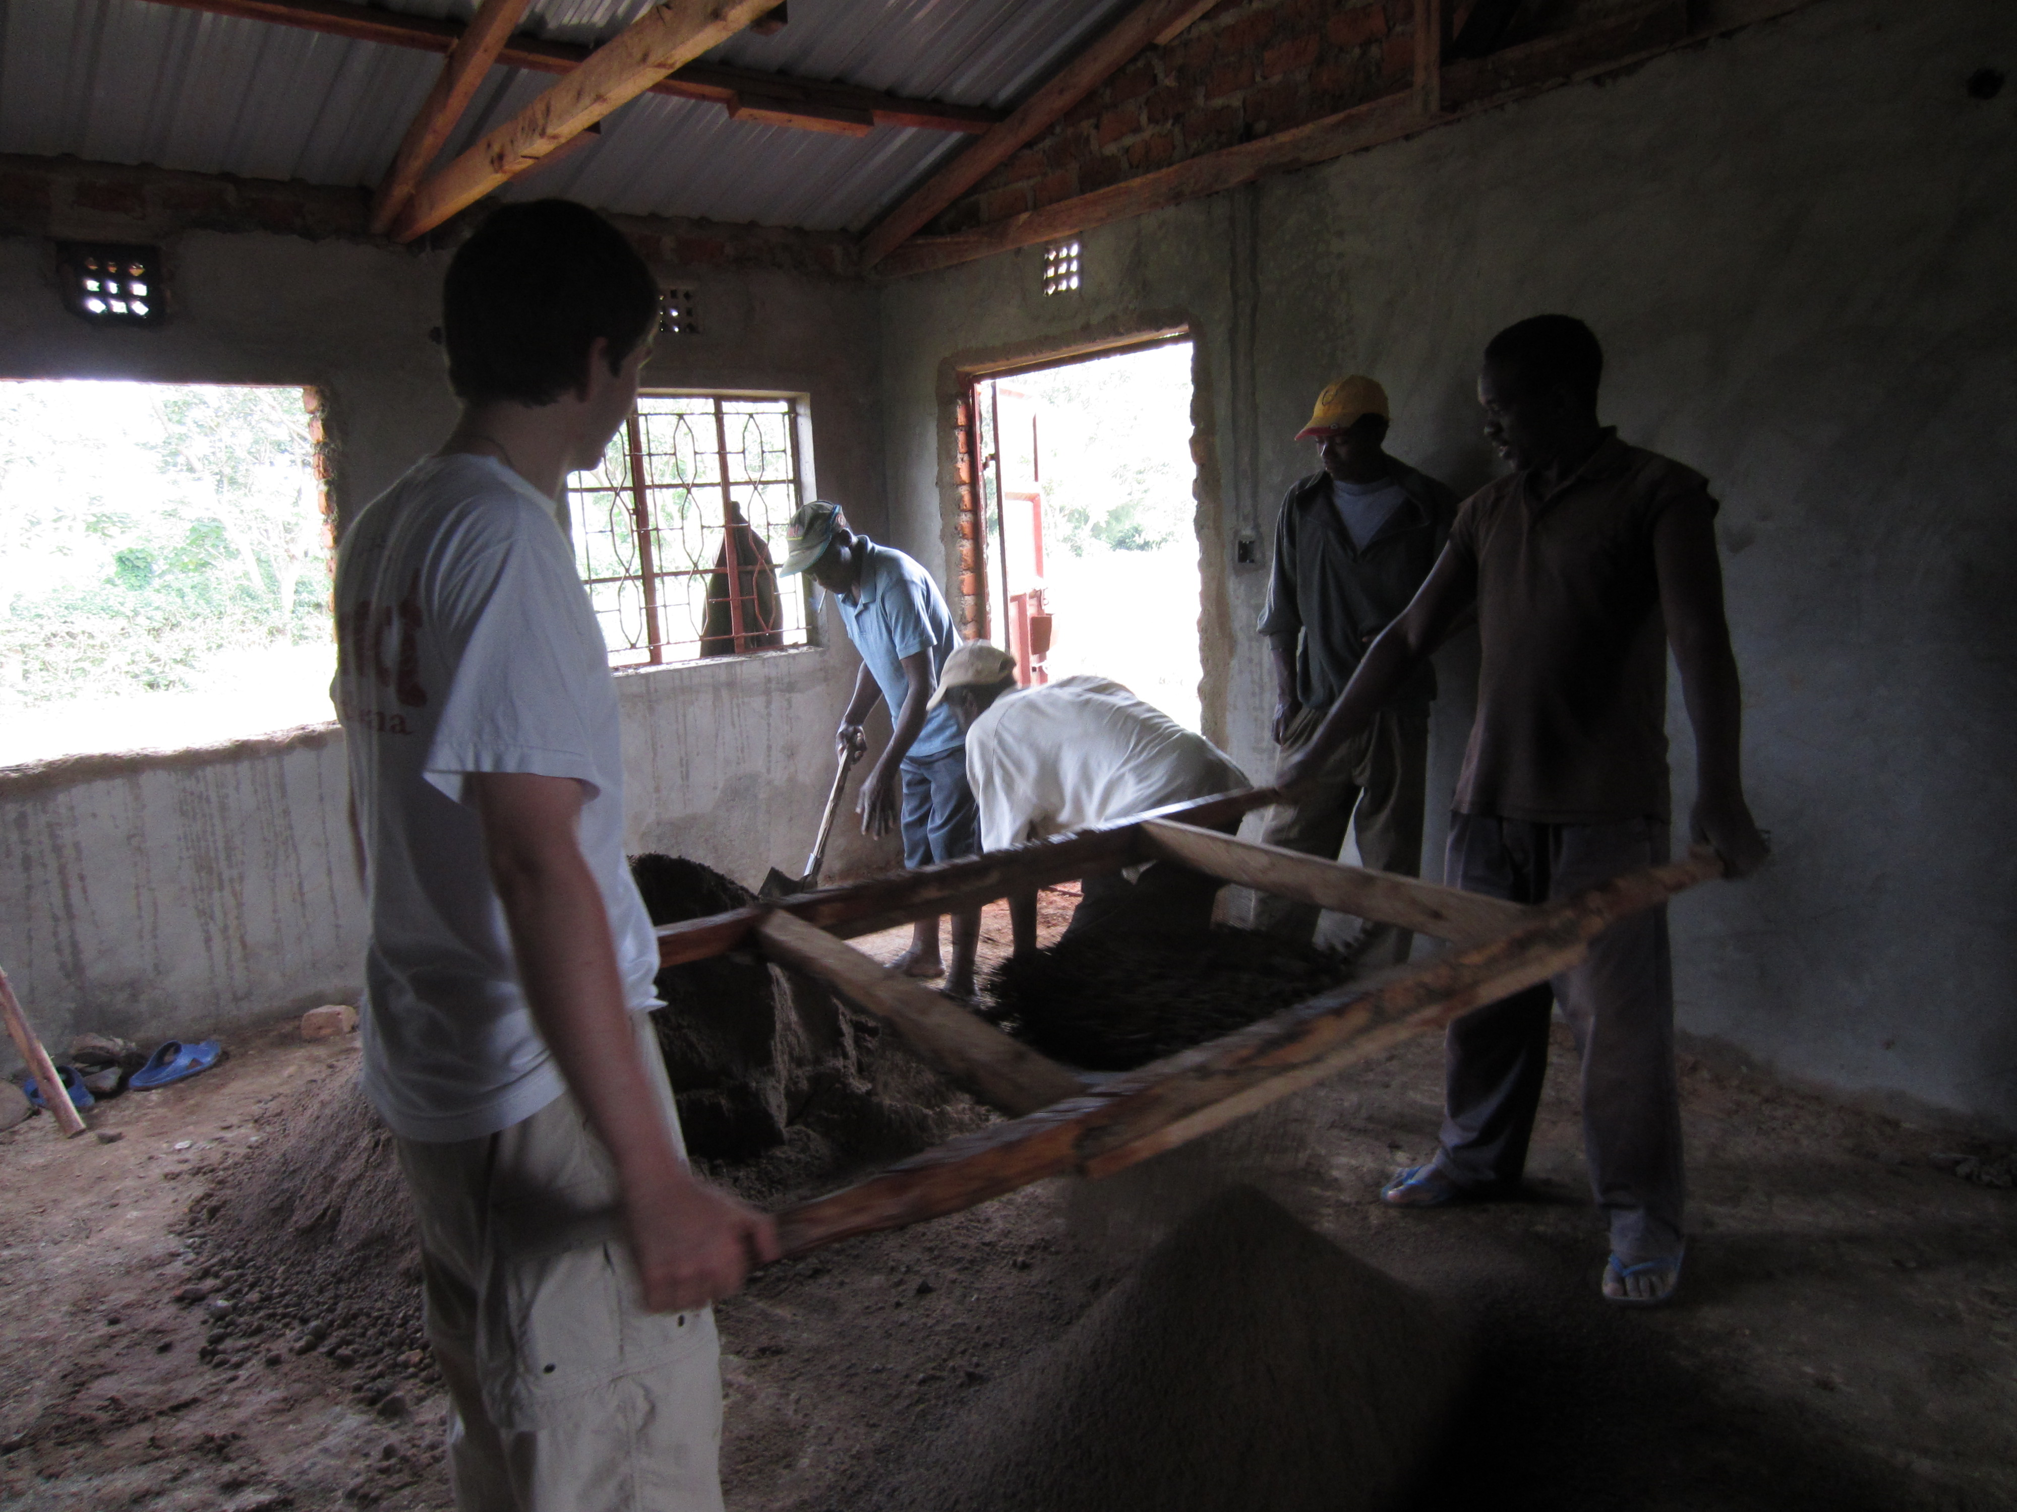

Slide 7
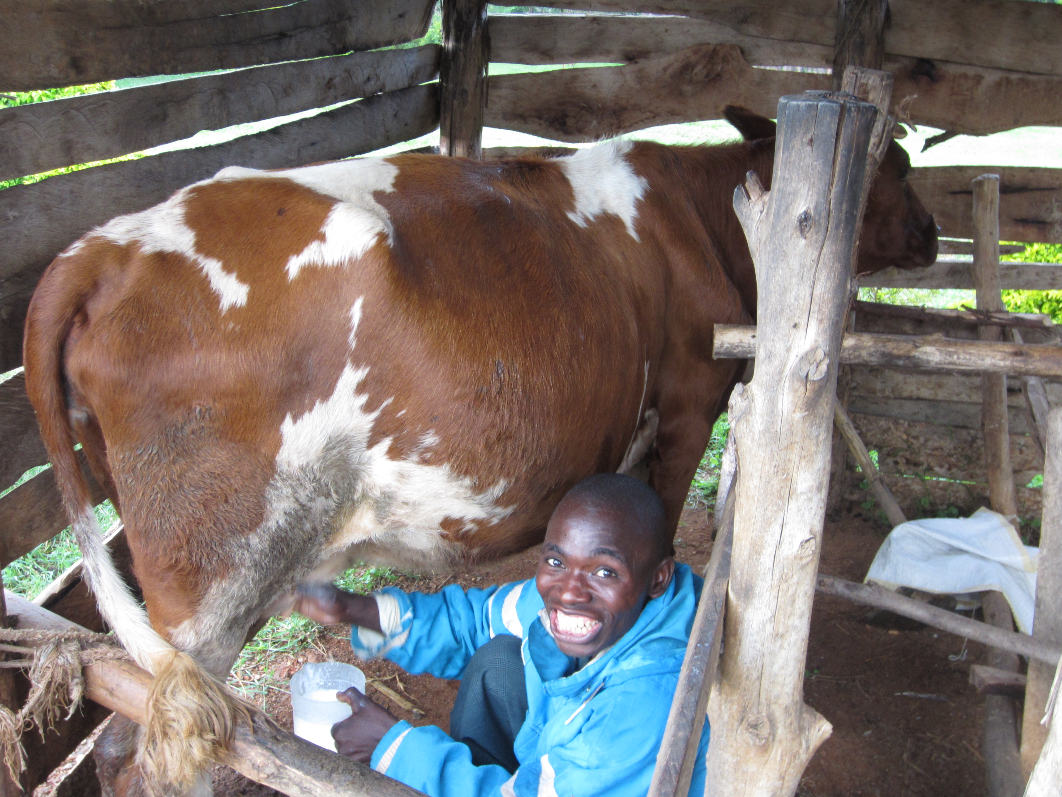

Slide 8
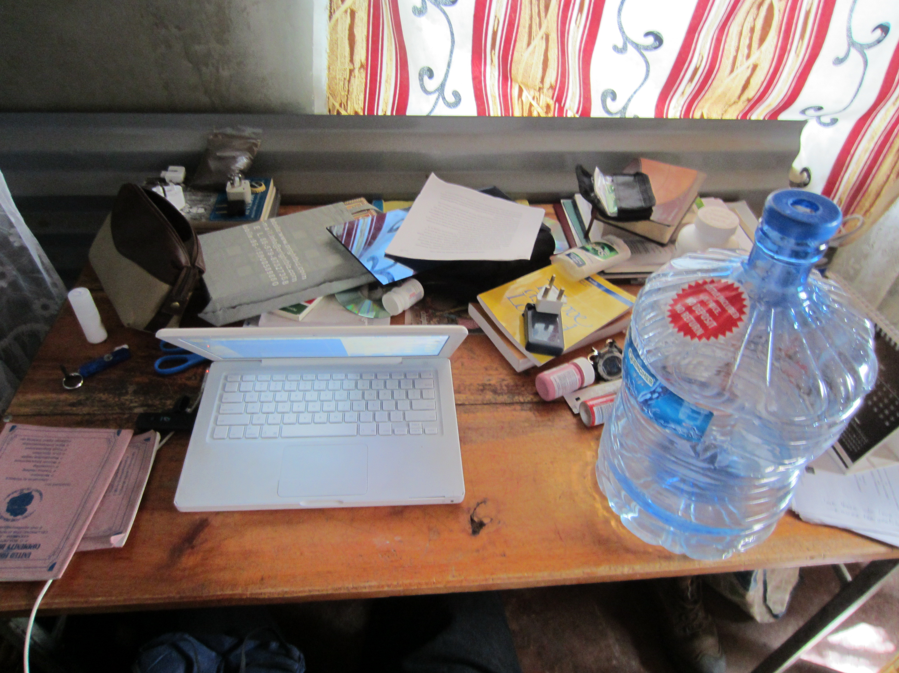

Slide 9
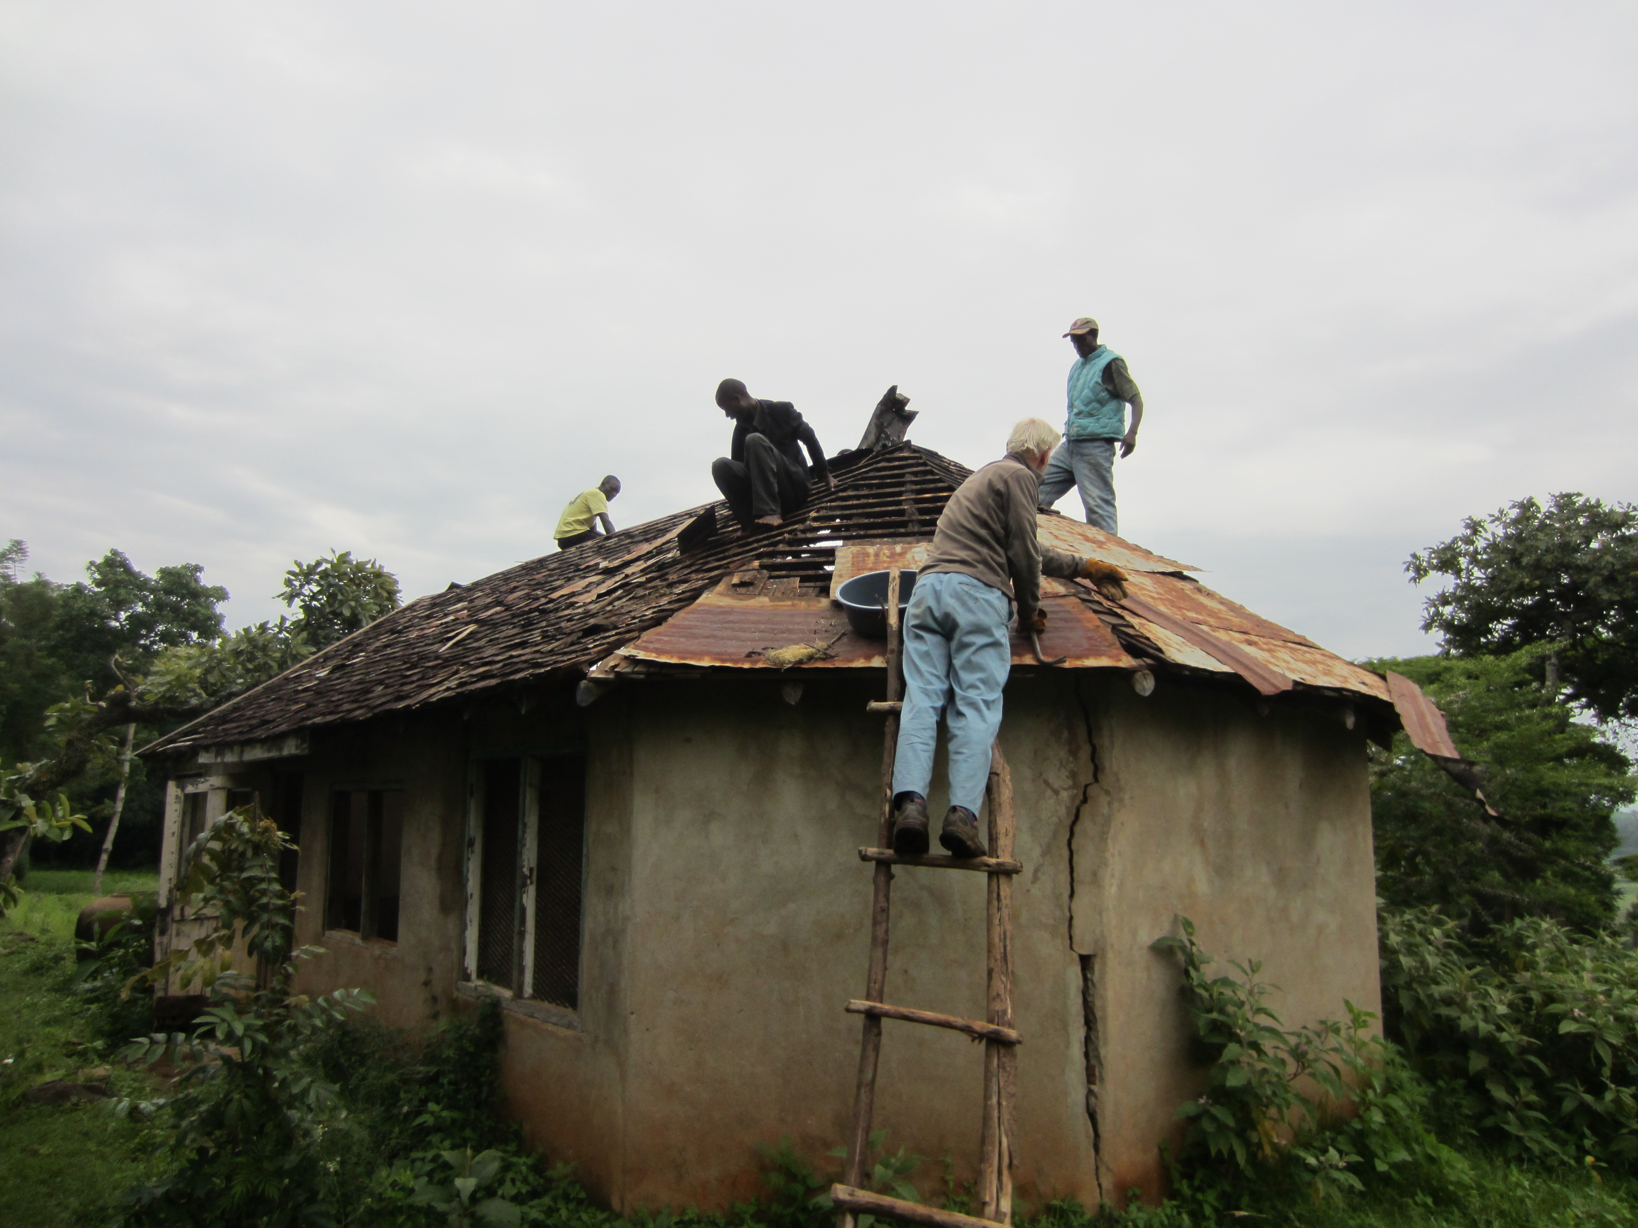

Slide 10
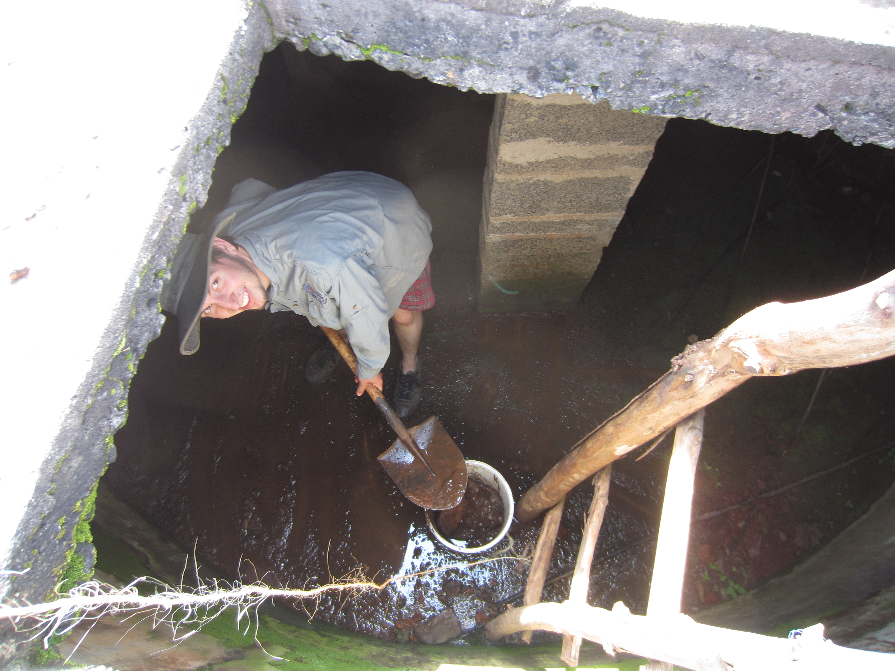

Slide 11
Part Two: Observations

Slide 12
Lessons from Rwanda
The people in Rwanda were less technologically advanced, poorer and yet happier and more pious than Westerners.
Would I find the same situation in Kenya?
Correlation? Causation?

Slide 13
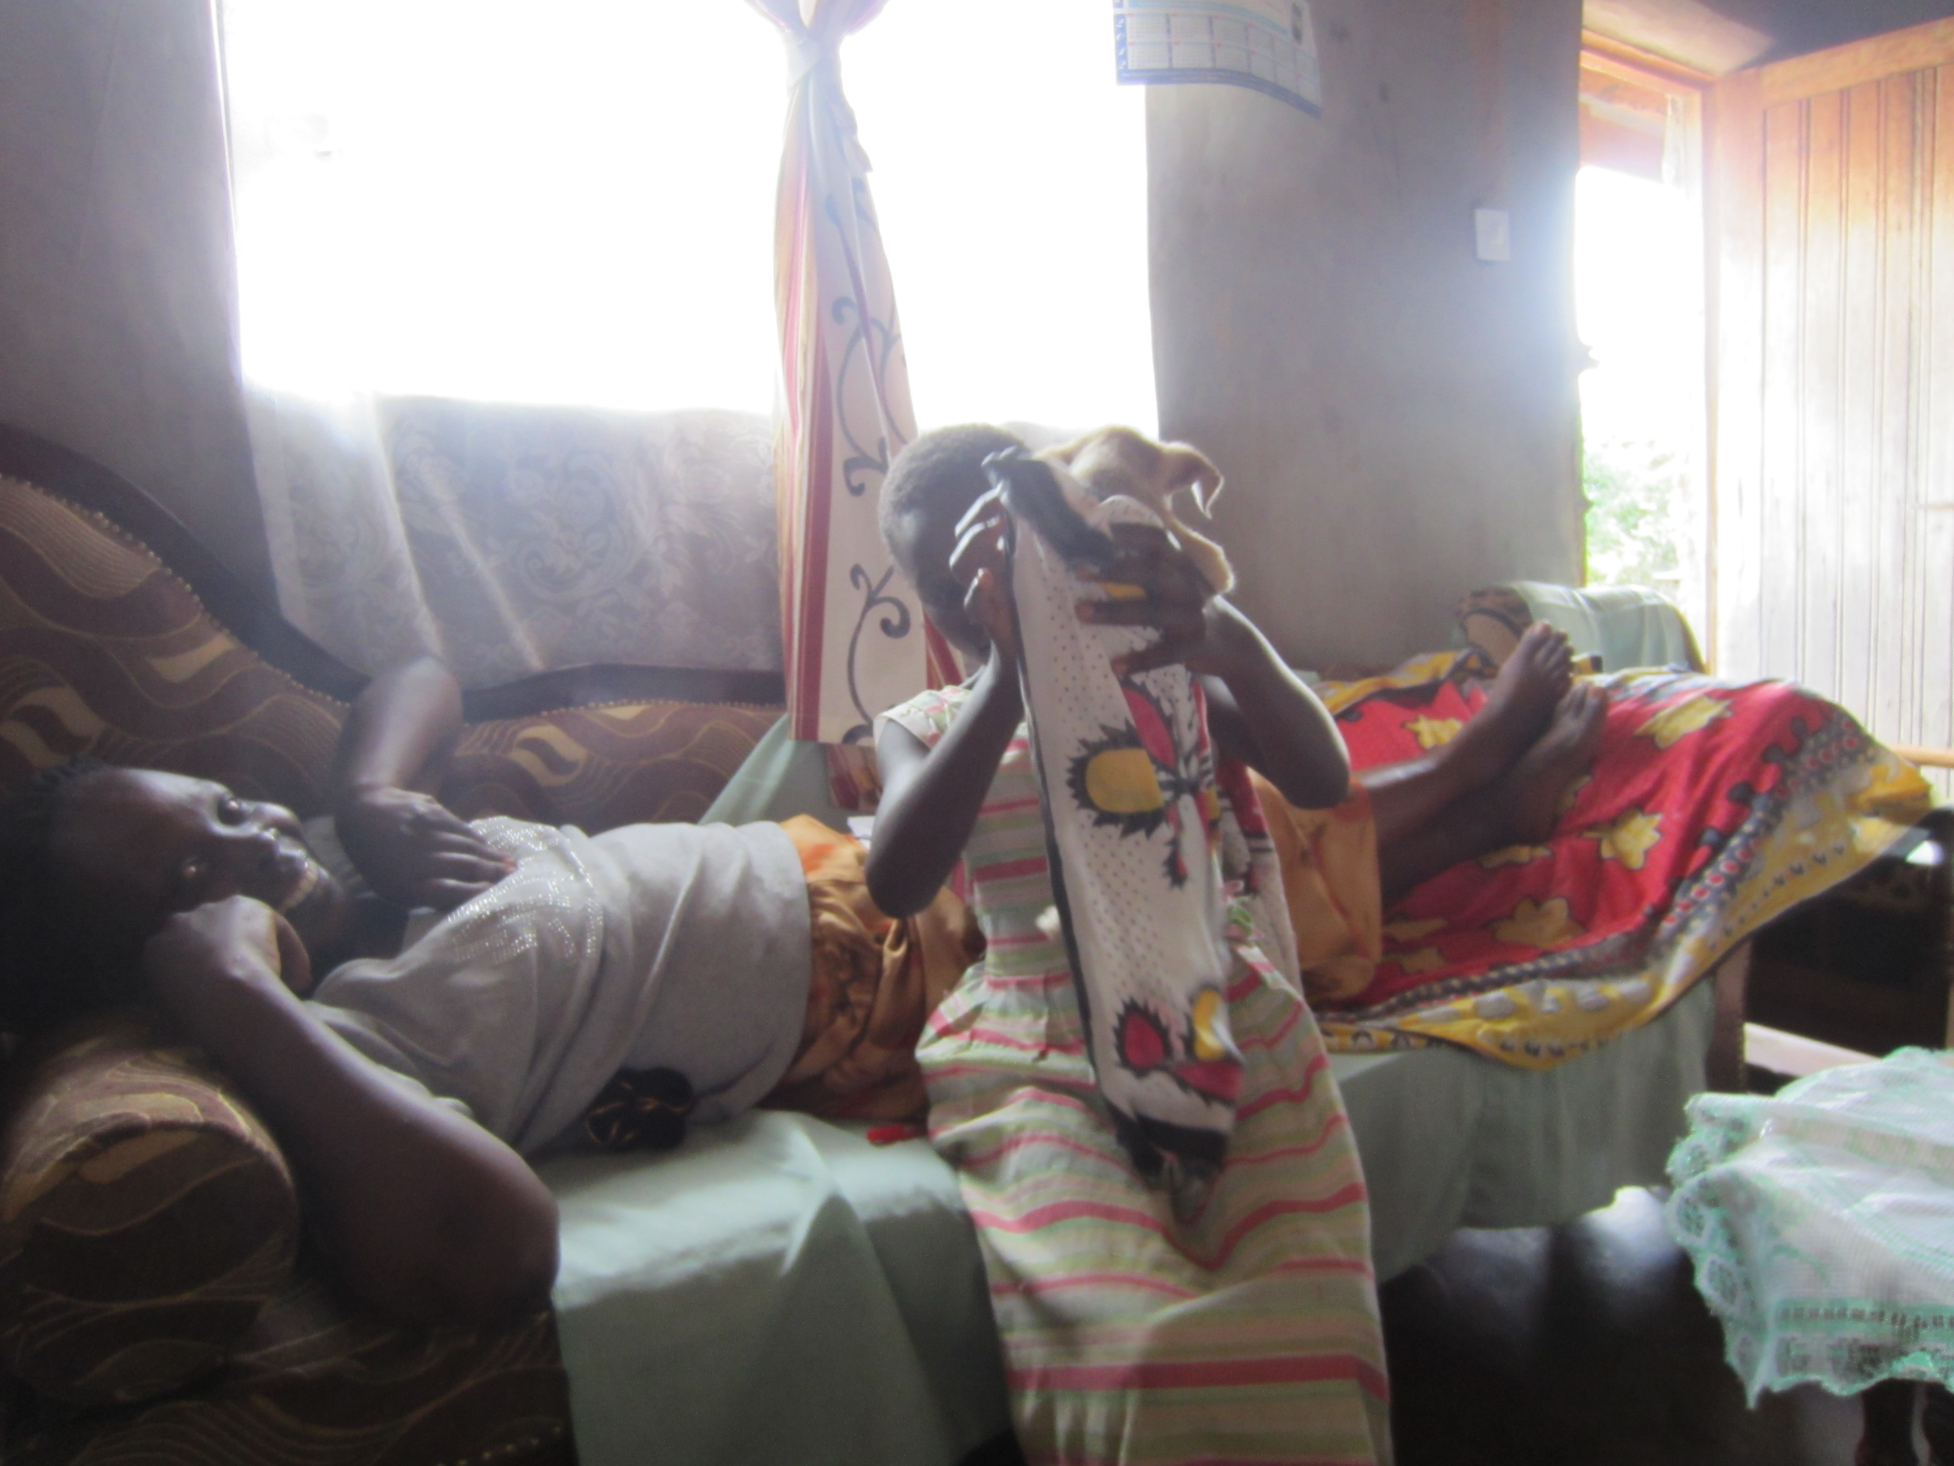
Happiness (furaha)

Slide 14
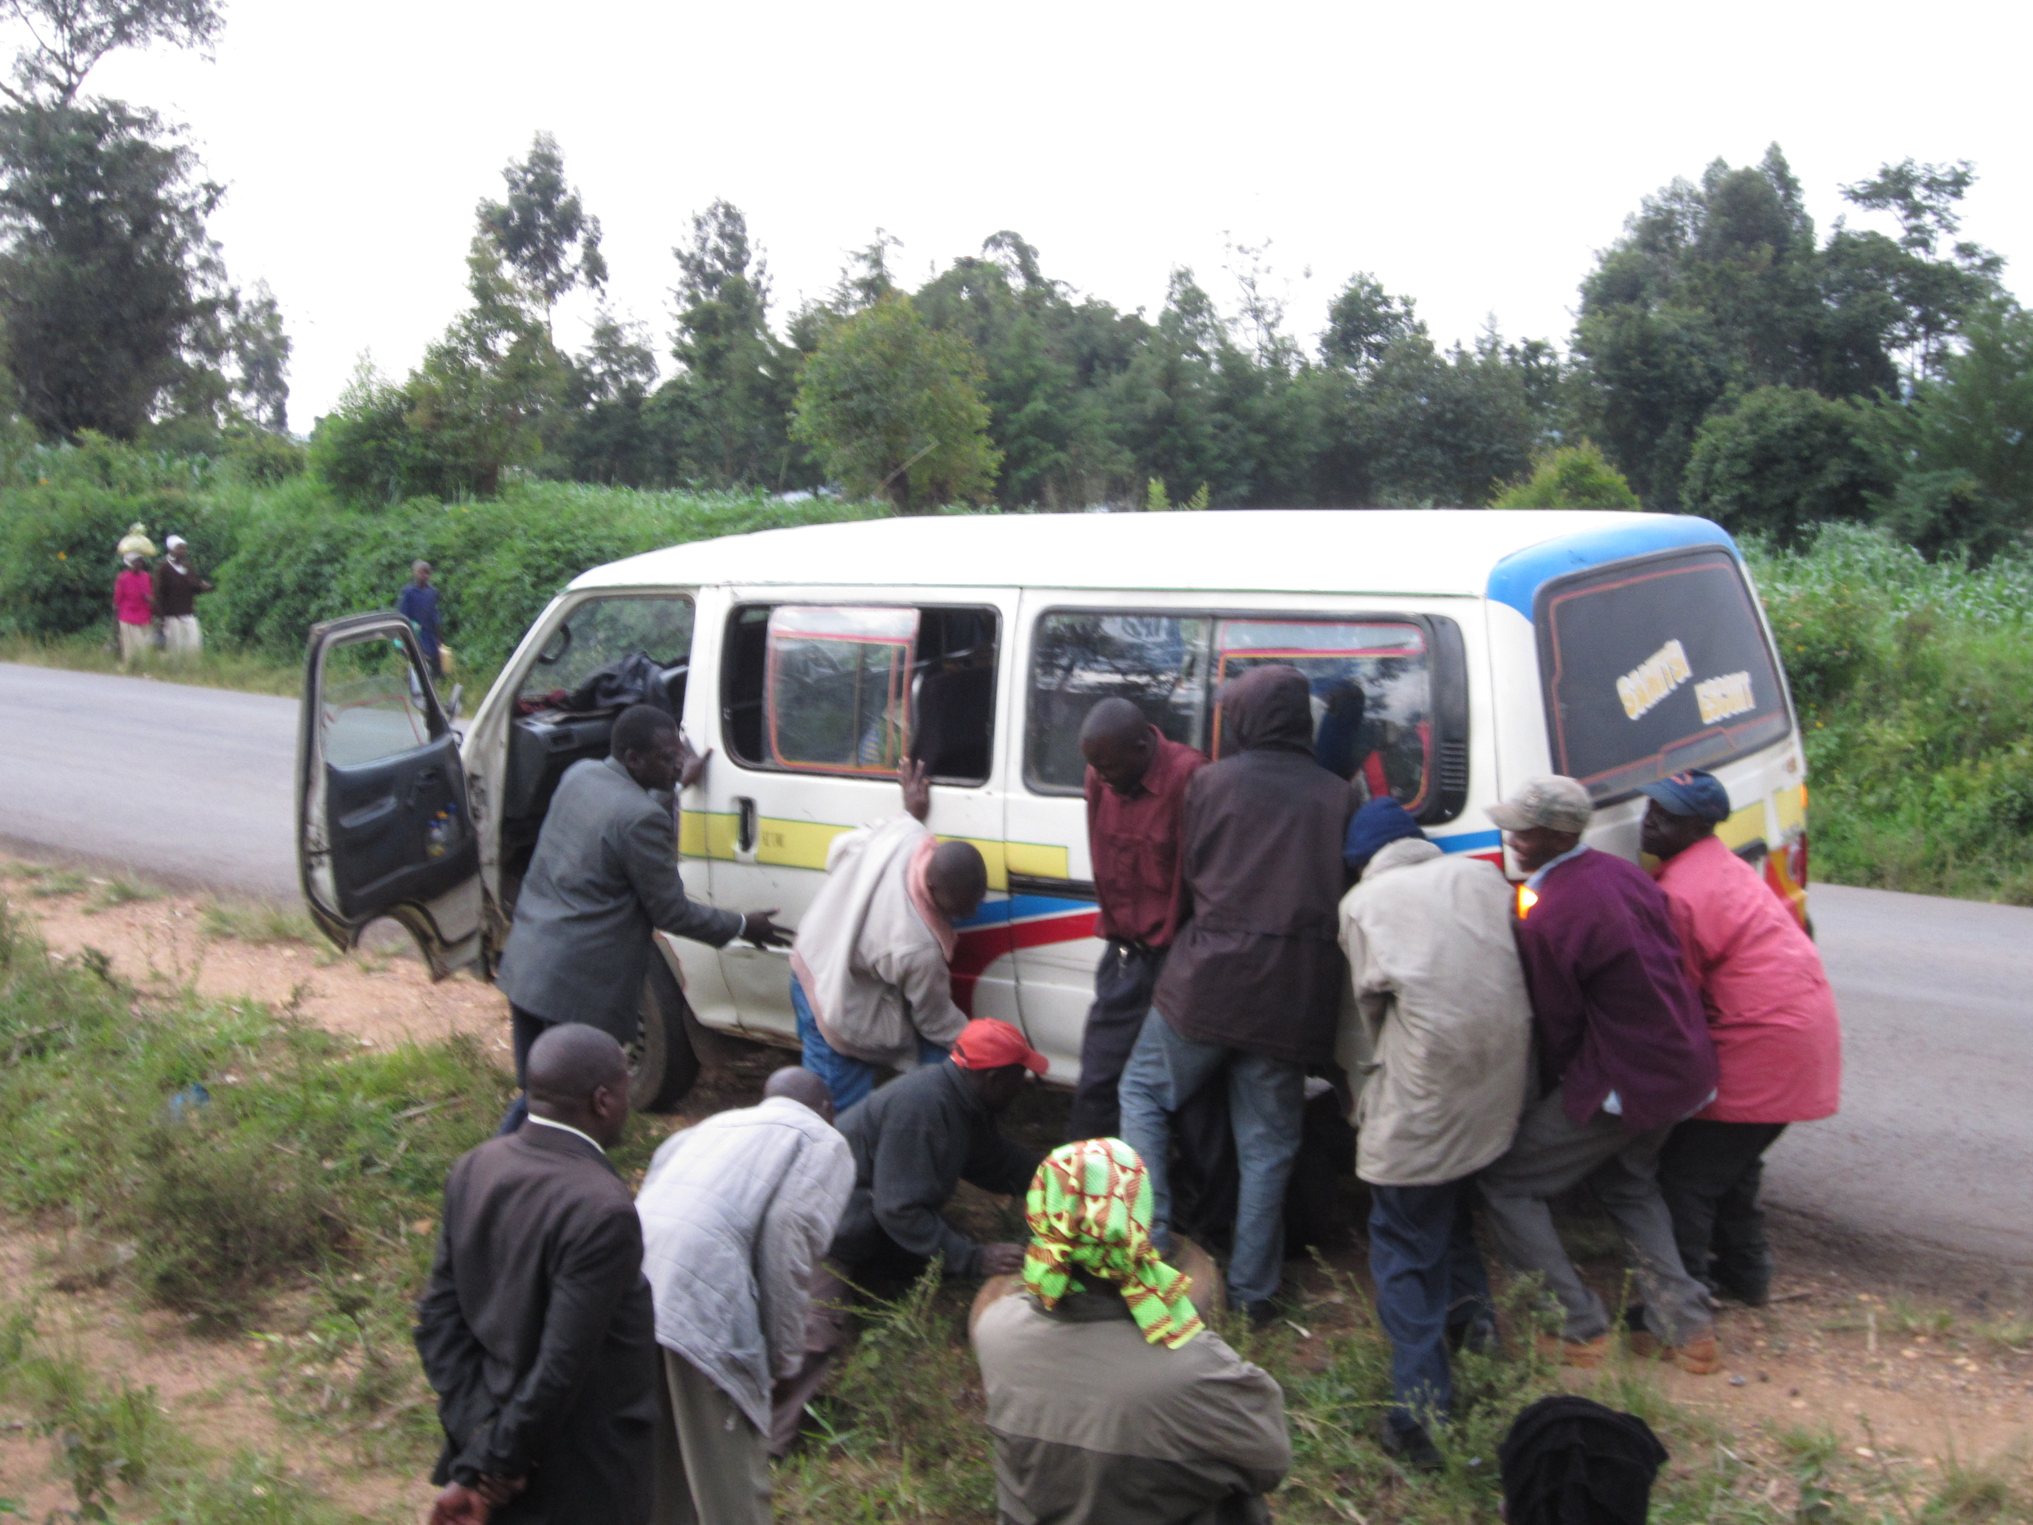
Harambee (“pull together”)

Slide 15
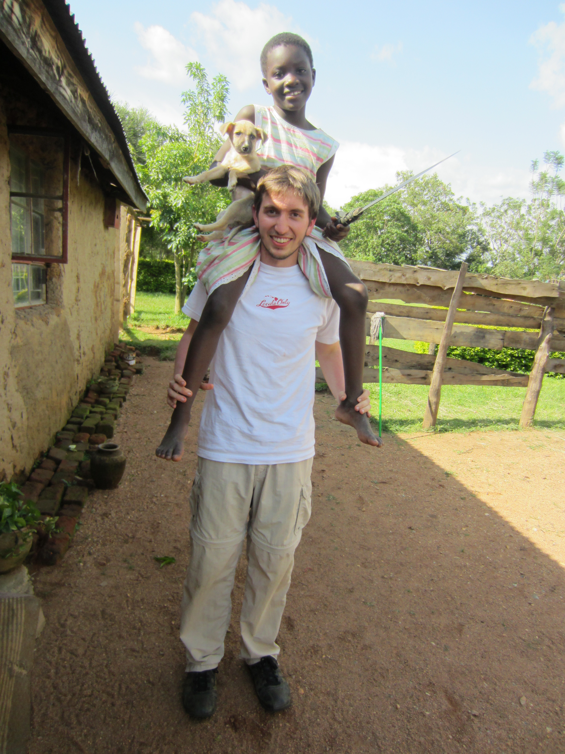
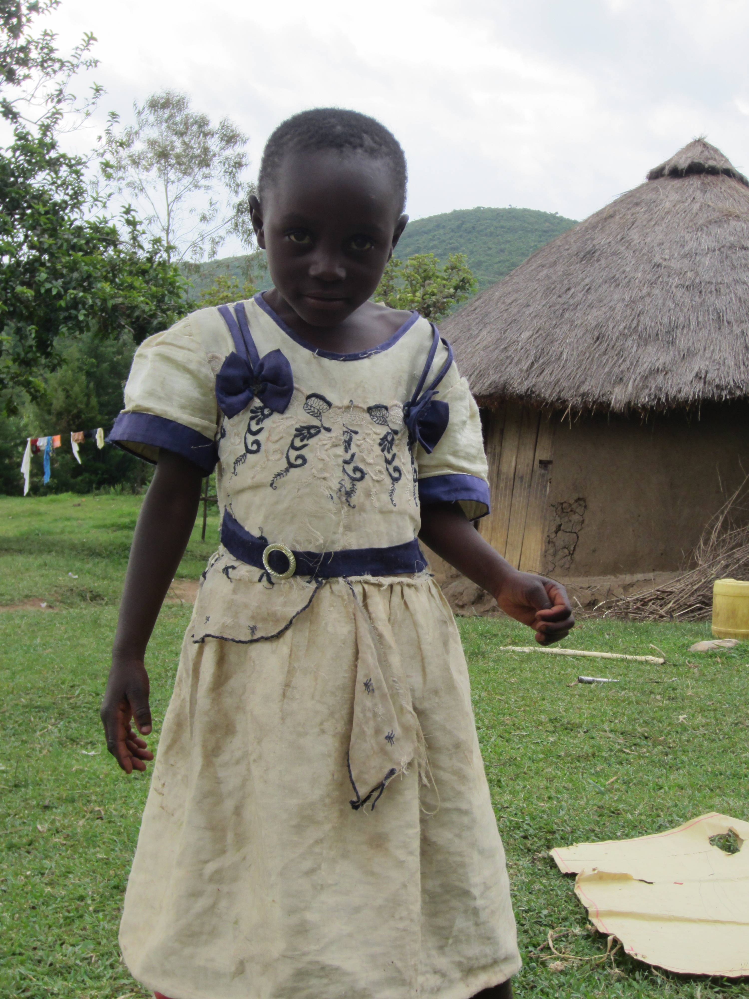
Children (watoto)

Slide 16
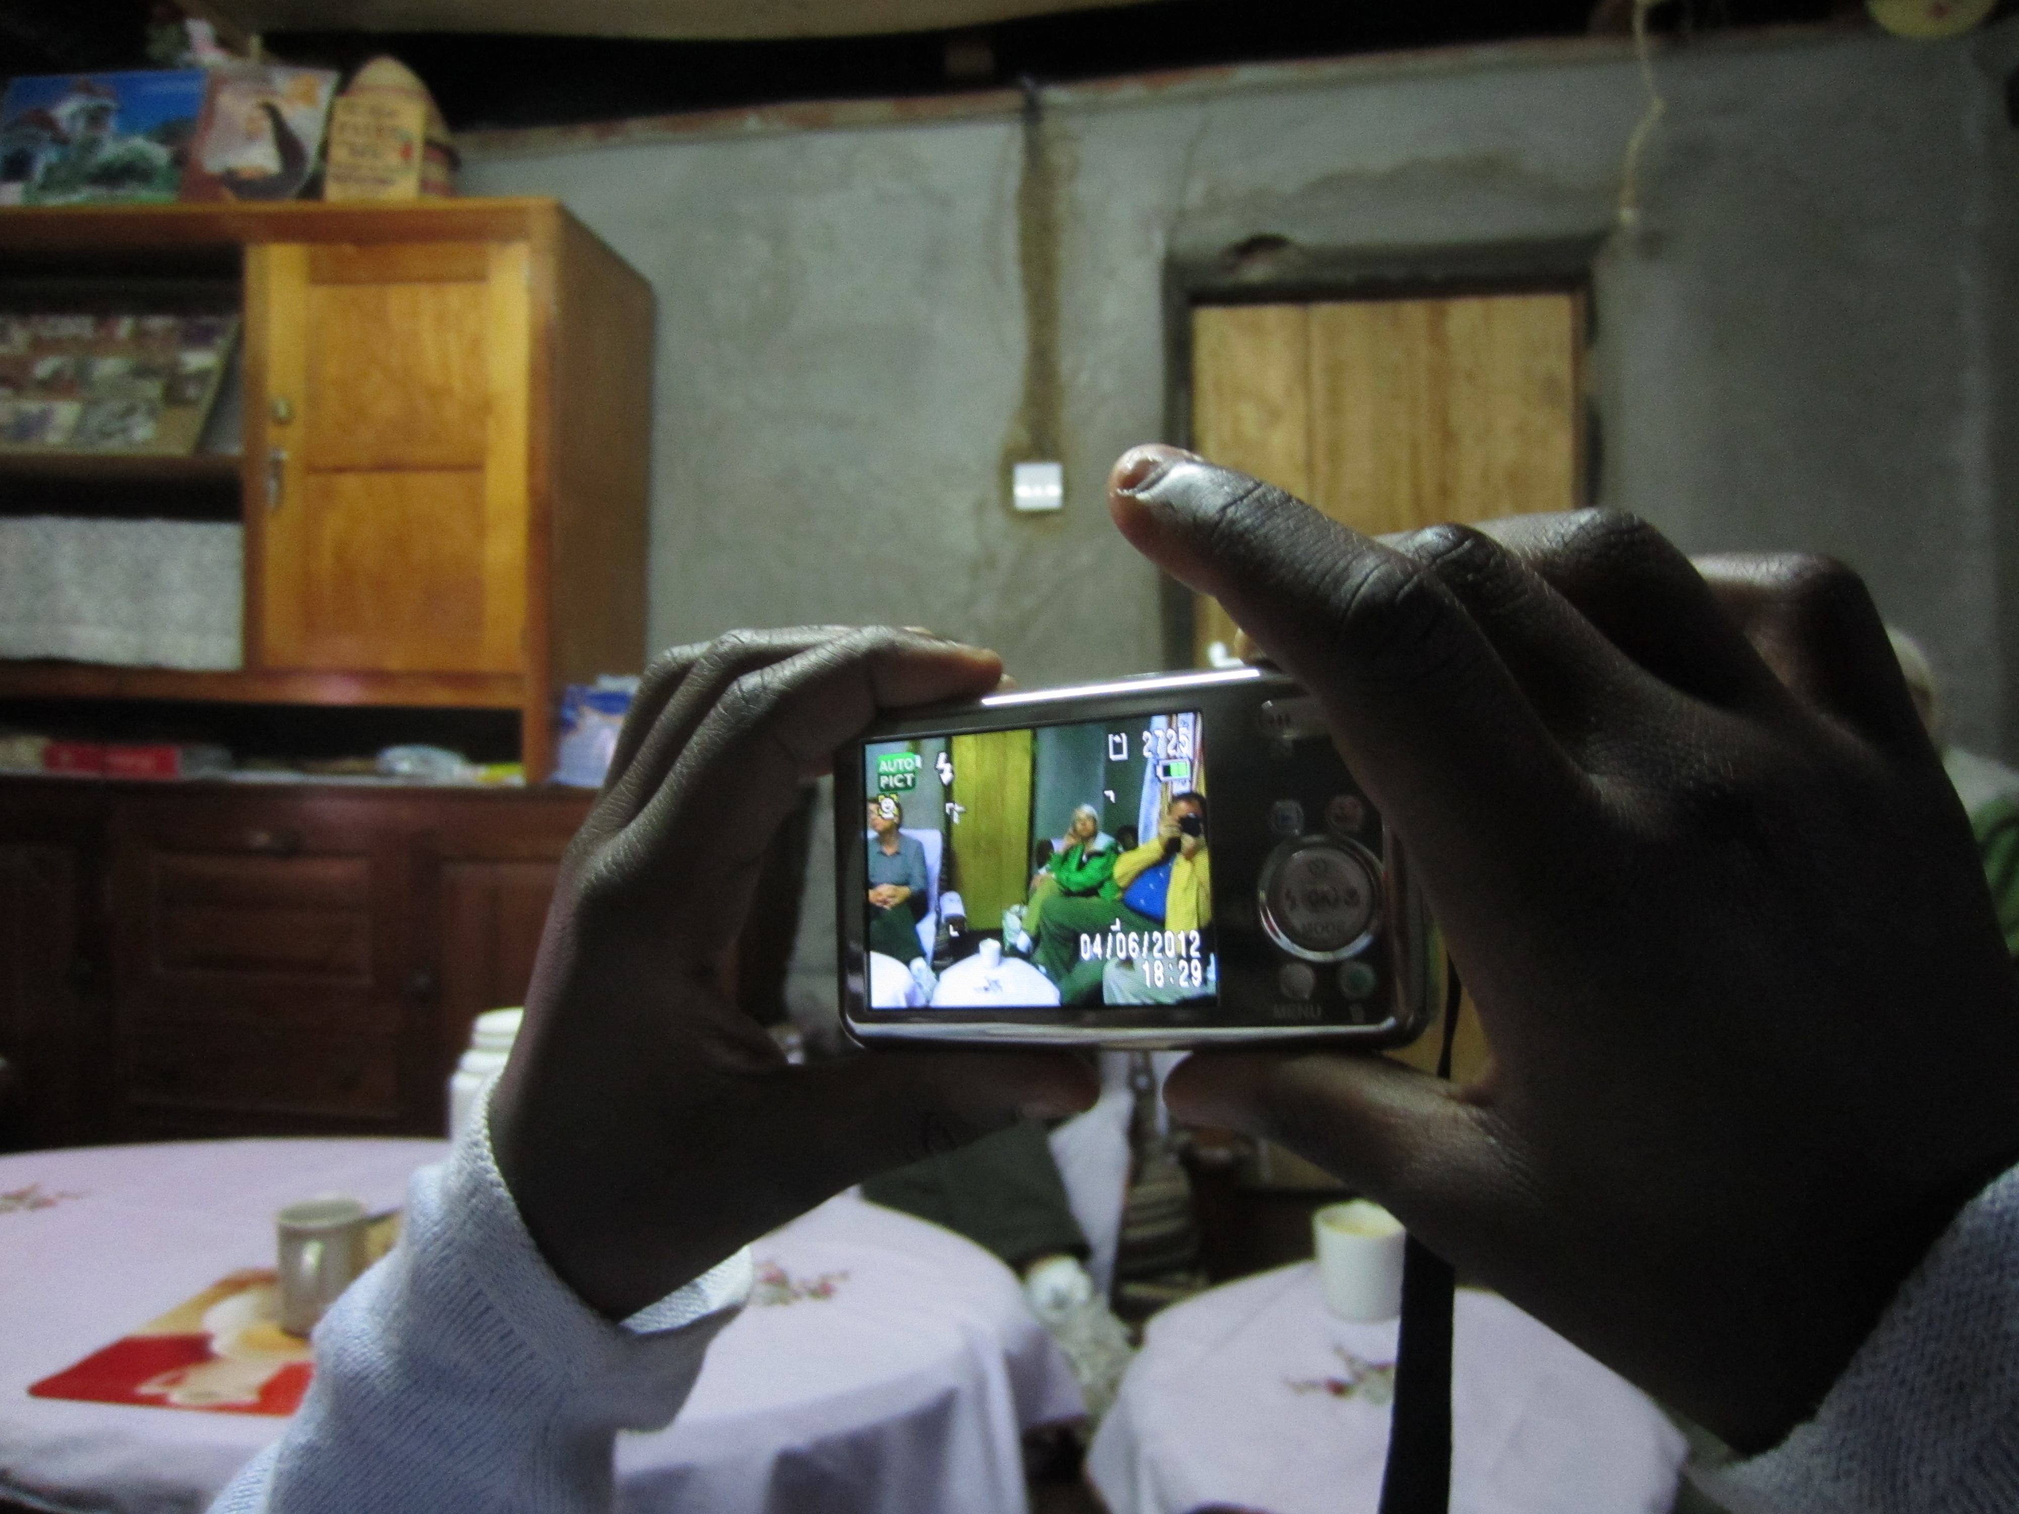
Rapidly-Advancing Technology

Slide 17
Question:
If the Kenyans (and Rwandans) are more loving, more genuine and happier than Westerners, should they consider resisting technological and economic change (and their associated cultural changes) in order to maintain their status quo?
And should we, as Christians, join them?

Slide 18
Answer: No. Why?
Choosing to ‘freeze’ wealth or technology at any level (a la Amish) would be arbitrary
One can never fully resist technological, economic, or cultural changes
What helps one’s spiritual growth may hurt another’s, and vice-versa
Christians are called to live (and evangelize) in the present age

Slide 19
So:
How, then, does a Christian -- and the Christian community -- harvest the ‘goods’ of technological and economic change, while avoiding the ‘bads’?
I’ll answer that question in…

Slide 20
Part Three: Theology

Slide 21
Ethical Flexibility in Christianity
The Apostolic Conference (Acts 15) versus Paul’s advice (1 Corinthians 8) about meat
Jesus doing ‘work’ on the Sabbath
Commandments that obviously cannot be universalized (“give all that you have to the poor”)
Is there a model that can make sense of this?

Slide 22
Epistemology
The inadequacy of secular philosophies at answering ethical questions
  ‘Natural’ Law, Utilitarianism
Any ethics dictated by God (the creator and owner of reality) are by necessity non-arbitrary
God as a ‘working assumption’

Slide 23


Slide 24
Intellectual Humility
An assumption of the existence of God in no way implies that our perceptions, interpretations and beliefs are the correct ones
We cannot ‘know’ anything about God, ethics or morality without direct revelation (I call this position ‘soft solipsism’)
Because there is no objective way to evaluate one religion / denomination / interpretation against another, we should be tolerant and pacifistic

Slide 25
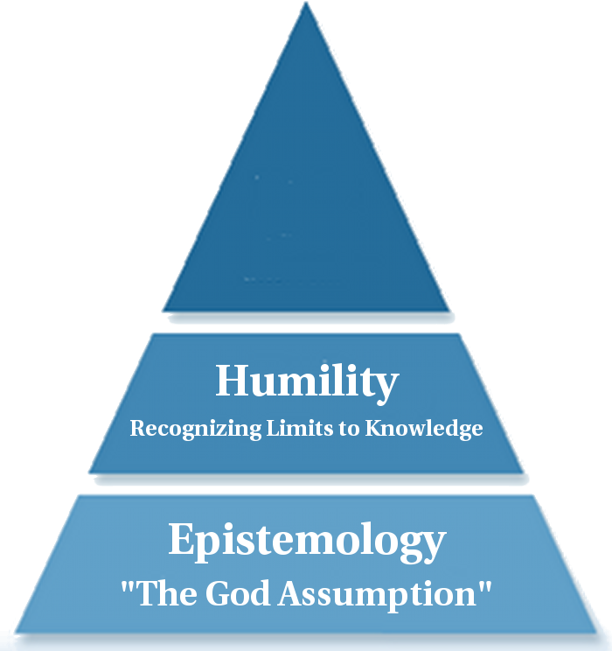

Slide 26
Purpose!
Kenyan Culture | Christian Parallel
Strong Devotion / Piety | The Great Commandment
Harambee | The Golden Rule
Loving and Genuine Relationships | Agape

Slide 27
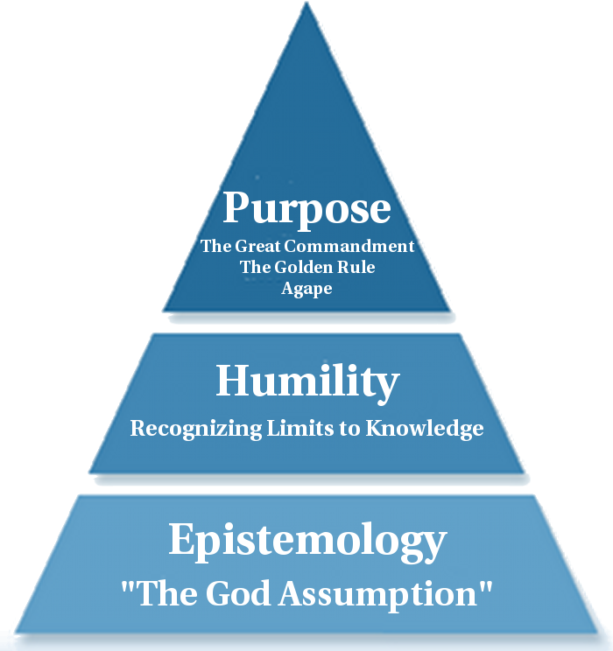

Slide 28
Applications
This model allows us to make case-by-case ethical decisions
The model reminds us of the basis for our beliefs, the limitations of our conclusions, and the ideals to which we aspire

Slide 29
Example
If I’m worried about the effect of Facebook on my spiritual well-being:
  Take a ‘fast’ from the offending technology
  Recognize the existence of a meaningful solution to the problem (Epistemology)
  Recognize the limitations of my conclusion, whatever it happens to be (Humility)
  Try to apply the principles of Christianity to my problem (Purpose)

Slide 30
Conclusions
I was wrong to reduce apparent causations (e.g. poverty and simplicity → piety and charity) into general, universal principles (we should all be poor, or ‘freeze’ technology)
Rather, we have to evaluate forms of wealth and technological innovations on a case-by-case, and individual-by-individual basis.
The same logic applies to situation ethics

Slide 31
Objections:
What’s to keep people from deluding themselves?
  Solution: Consult the Christian community for strength and guidance
How do I know that I’m on the right path?
  Solution: Consult with Scripture
Isn’t this all subjective?
  Solution: Accept that you are responsible for the fruits of your actions

Slide 32
Scripture
Community
Individual Responsibility

Slide 33
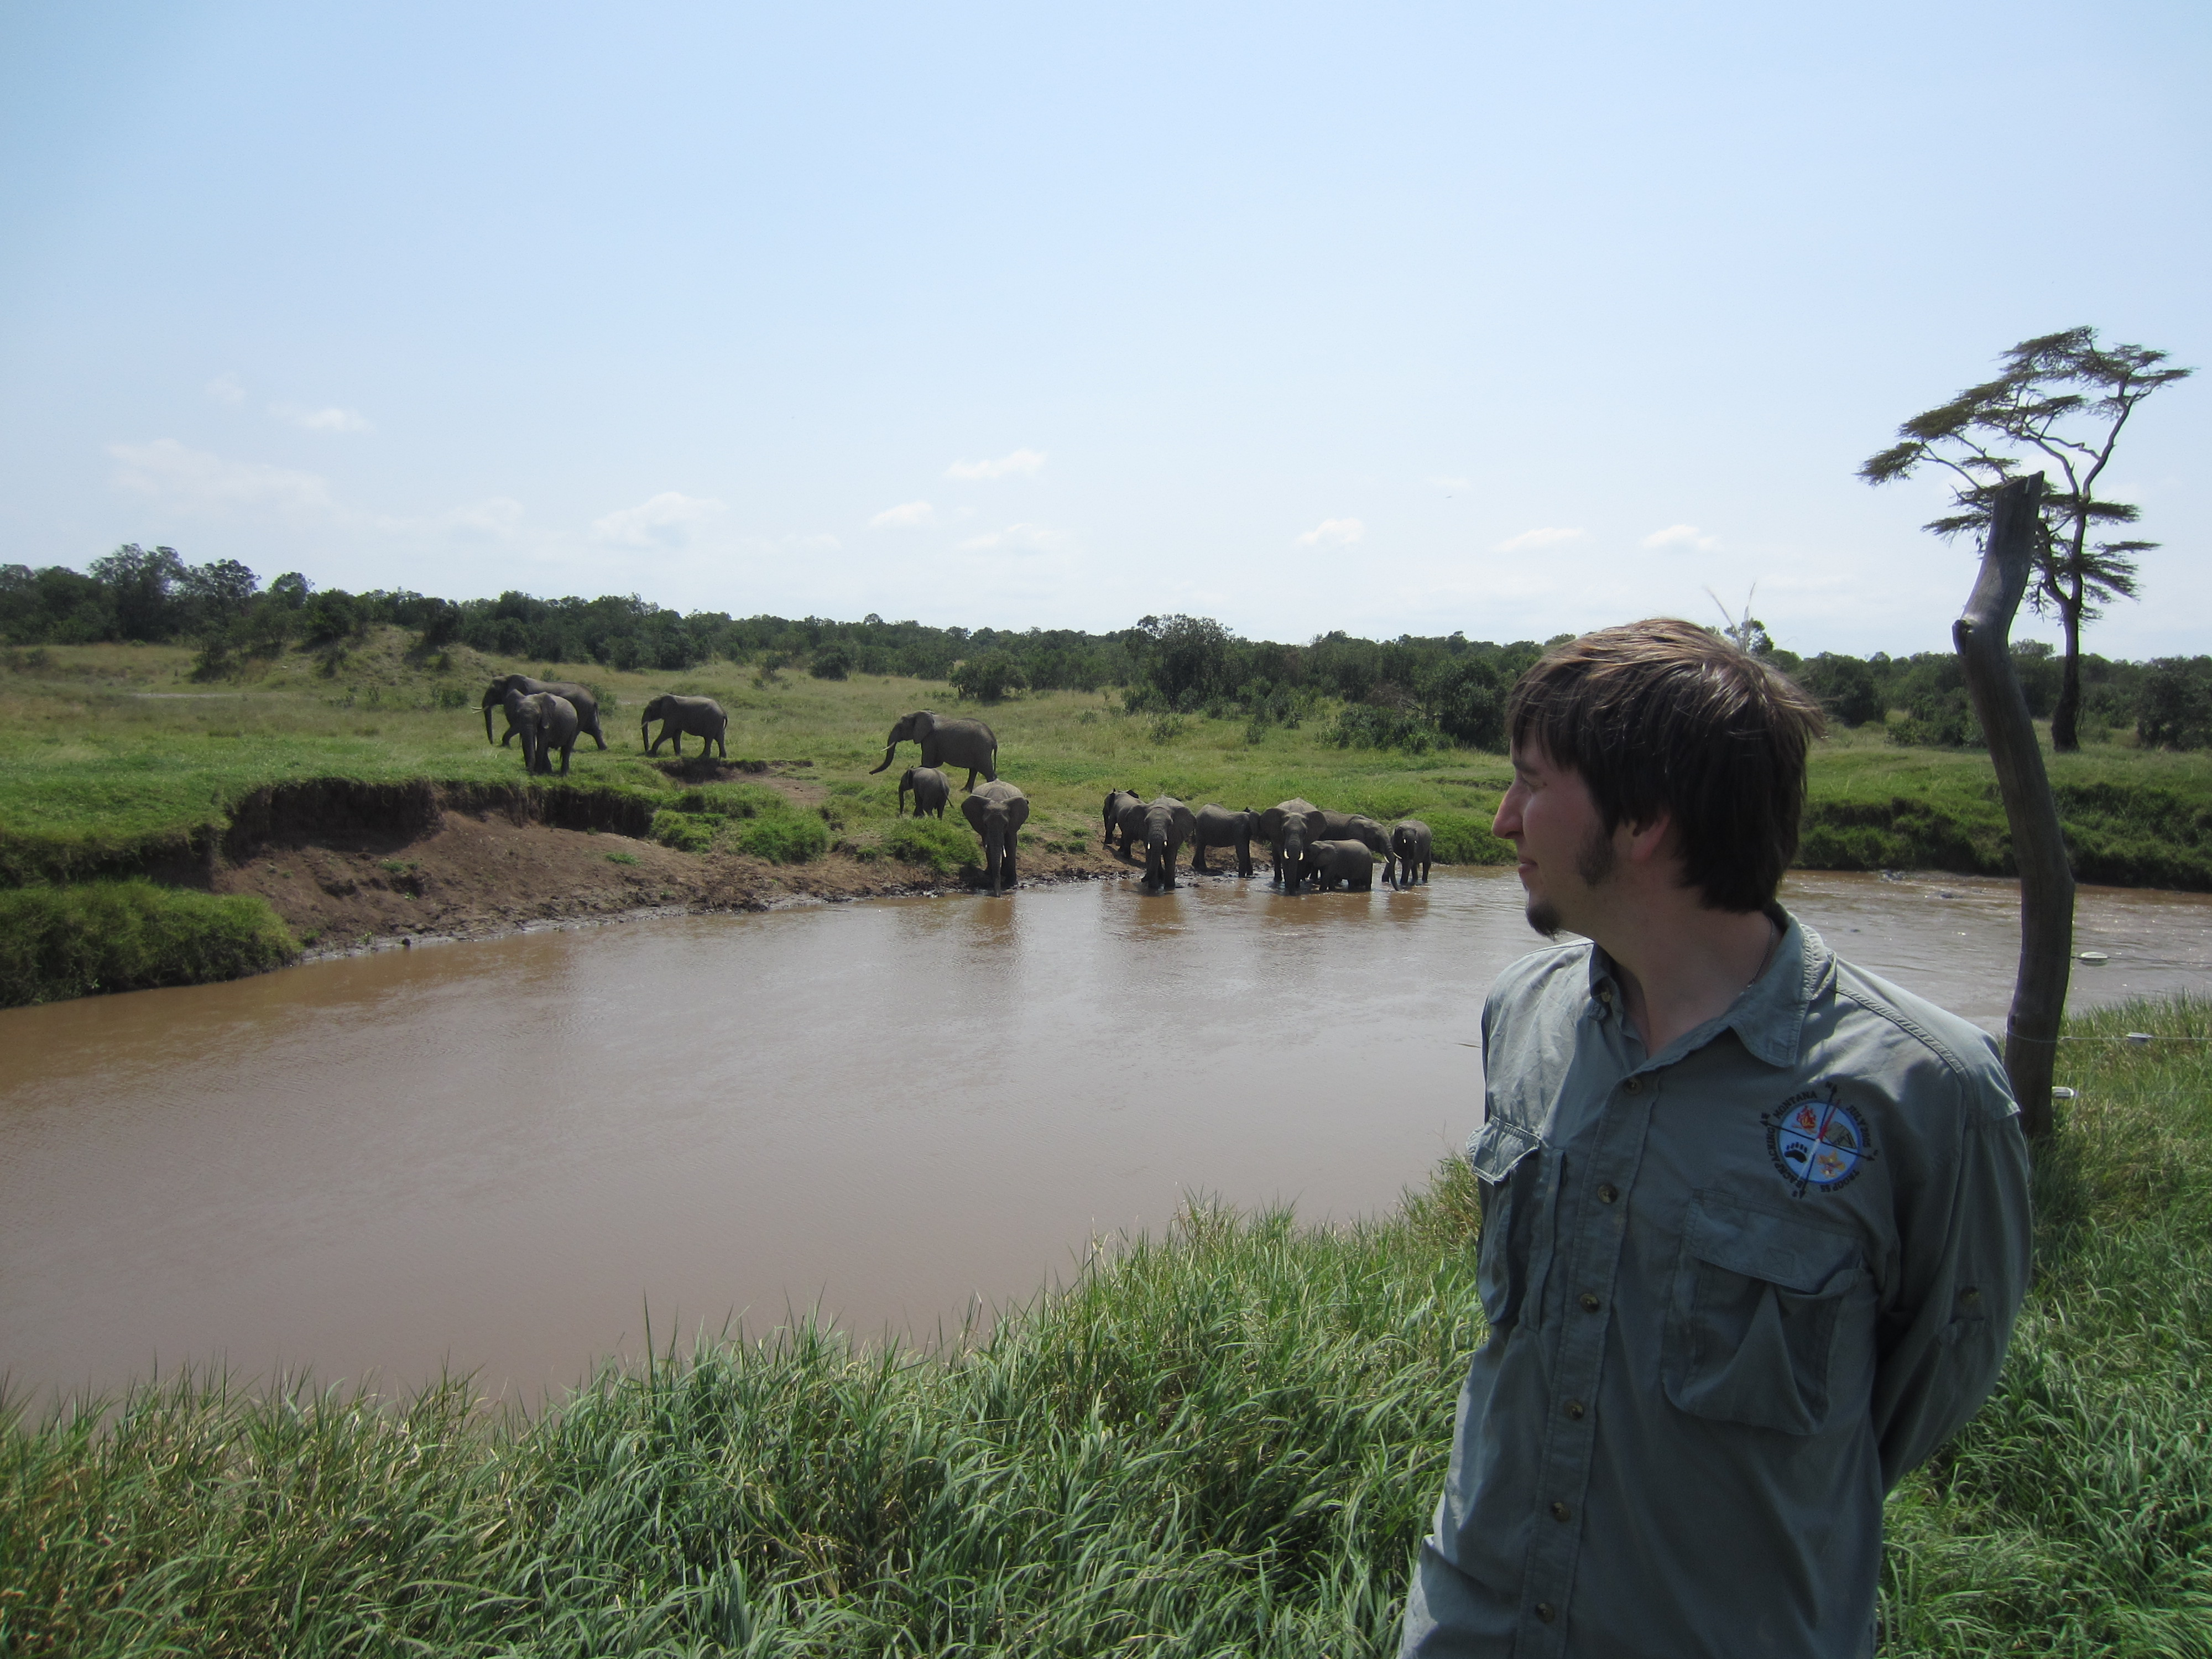
Thank You to the PLT

